Slide 1
Multivariate Analysis of Variance (MANOVA)
Prof. Andy Field

Slide 2
Aims
When and Why do we Use MANOVA?
Issues for MANOVA Analysis
Theory Behind MANOVA:
SSCP Matrices
Discriminant Variates
MANOVA Test Statistics

Slide 3

When And Why
To test for differences between groups
When we have Several Outcome variables (DVs)
Better than Multiple ANOVA
Controls familywise error rate (Type I error)
Takes account of relationships between DVs

Slide 4

Issues in MANOVA
Selecting Dependent Variables
Test Statistics (Choice of four)
Power
Power depends upon correlations between Dependent Variables
Conflicting evidence about Test Power

Slide 5
Theory: An Example
Efficacy of psychotherapy on OCD
Three Groups:
Cognitive Behaviour Therapy (CBT)
Behaviour Therapy (BT)
No Treatment (NT)
Two Outcome Variables (DVs):
Obsession-related Actions
Obsession-related thoughts

Slide 6
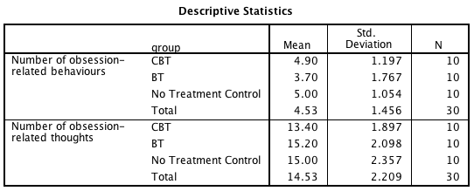
Descriptive Statistics

Slide 7
Theory of ANOVA (Revision)
SS_{T}
Total Variance In The Data
SS_{M}
SS_{R}
Improvement Due to the Model
Error in Model
F ∝ SS_{M}/SS_{R}

Slide 8
If We Did Separate ANOVAs…

Slide 9
Cross Products

Slide 10
Total Cross Products

Slide 11
Residual Cross Products
CBT
BT
NT

Slide 12
Residual Cross Products

Slide 13
Model Cross Products

Slide 14
Sums of Squares

Slide 15
MANOVA Matrices: Total SSCP (T)

Slide 16
MANOVA Matrices: Residual SSCP (E)

Slide 17
MANOVA Matrices: Model SSCP (M)

Slide 18
An Equivalent to F …

Slide 19
The Result …

Slide 20
Discriminant Variates

Slide 21
Eigenvalues (λ_{i})

Slide 22
Pillai-Bartlett Trace

Slide 23
Hotelling’s Trace

Slide 24
Wilk’s Lambda

Slide 25
Roy’s Largest Root

Slide 26
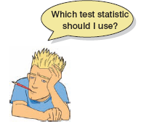
Which Test Statistic?
Issues to Consider
Power
Robustness
Equality of Sample Sizes
Pillai’s Trace
Robust when sample sizes are equal.

Slide 27
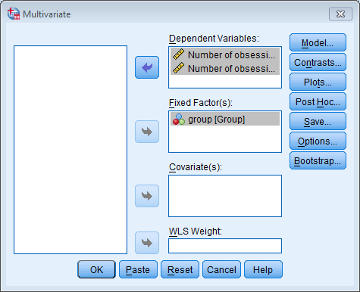
Doing MANOVA

Slide 28
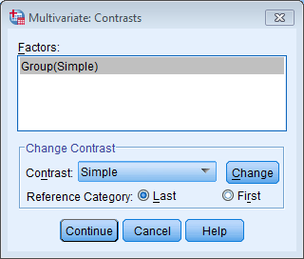
MANOVA Contrasts

Slide 29
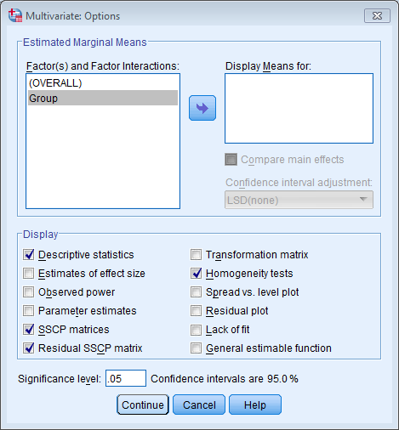
MANOVA Options

Slide 30
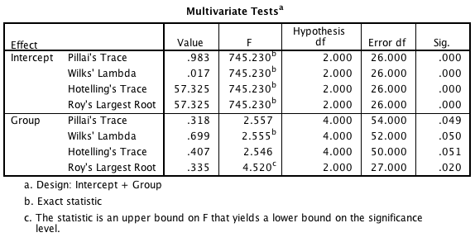
Main Output

Slide 31
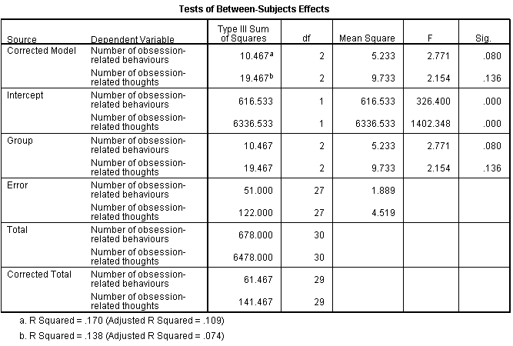
ANOVAs

Slide 32
Following MANOVA with Discriminant Function Analysis

Slide 33
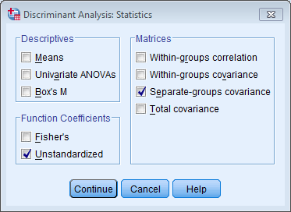
Discriminant Function Analysis: Statistics

Slide 34
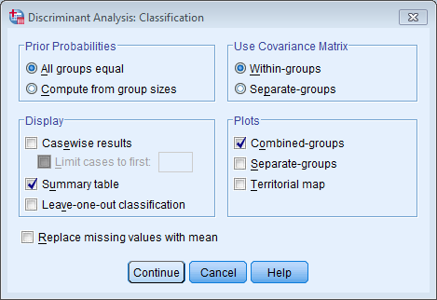
Discriminant Function Analysis: Classification

Slide 35
Discriminant Function Analysis

Slide 36
Discriminant Function Analysis

Slide 37
Discriminant Function Analysis

Slide 38
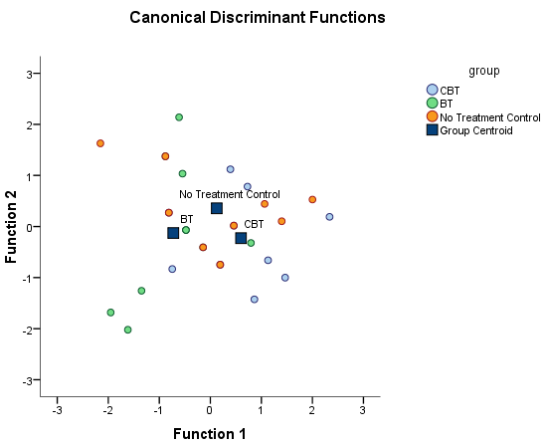
Discriminant Function Analysis

